Slide 1

Heartbeat audio
classification
Advanced Biomedical Machine Learning project
University of Pavia
Andrea Alberti
Davide Ligari
Notes:
Good morning, everyone.
Today, we are excited to present our project on heartbeat audio classification.
Our team, composed of myself, Davide and Andrea Alberti,

Slide 2
TABLE OF CONTENTS
01.
02.
03.
04.
05.
06.
INTRODUCTION
DATASET
FEATURES
MODELS
ANALYSIS
FUTURE WORKS
Notes:
First, we will introduce the problem and goal
Next, we will delve into the dataset we utilized, highlighting the features we extracted from the heartbeat audio recordings.
Finally, we will present the various models we trained, discussing their performance, analysis, and limitations.

Slide 3
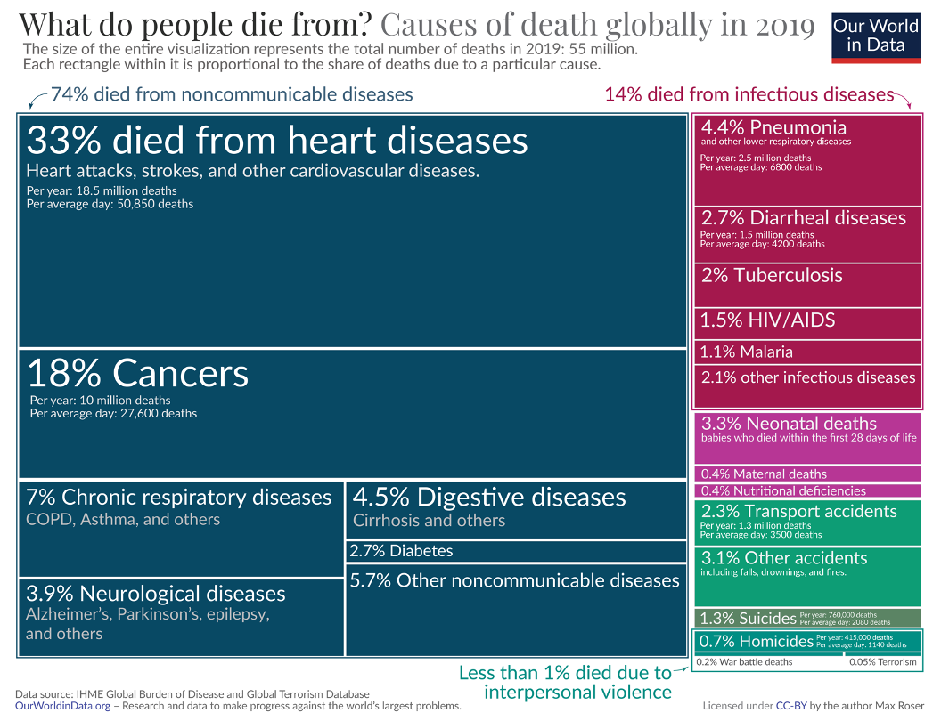
INTRODUCTION
1st
Death cause in the world
50.850
Average deaths per day
18,5 M
Death per year
Notes:
Heart disease is the leading cause of death worldwide, claiming about 50 thousands deaths per day.
This staggering statistic shows the need of advanced technologies to aid early detection and diagnosis.

Slide 4
STATE OF ART
AUTHORS | MODELS | FEATURES | RESULTS | ANNO | DATASET
W. Zhang et al ^{[1]} | SVM | Spectrogram | 0.76 Precision | 2017 | N, M, EH, AR
SW. Deng et al ^{[2]} | SVM | DWT | 0.76 Precision | 2016 | N, M, EH, AR
A. Raza et al ^{[3]} | LSTM | 1D time series | 0.80 Accuracy | 2019 | N, M, ES
T. Alafif et al ^{[4]} | 2D-CNN + transfer learning | MFCC | 0.89 Accuracy | 2020 | N, A
Noman et al ^{[5]} | Ensemble CNN | 1D time series + MFCC | 0.89 Accuracy | 2019 | N, A
Chen et al ^{[6]} | 2D CNN | WT + Hilbert-Huang | 0.93 Accuracy | 2018 | N, M, ES
Our Model | Ensemble Model (MLPs + RF) | MFCC + Chroma + ZCR | 0.88 Accuracy | 2024 | AR, M, N, EH, ES
LEGEND: AR: Artifacts, M: Murmurs, N: Normals, EH: Extra Heart Sound, ES: Extra Systole, A: Abnormal
Notes:
In recent years, various research tried to address this problem. However, as highlighted by this table, the existing models have some limitations:
Simpler models, such as Support Vector Machines (SVM), do not perform well, achieving only a 0.76 precision, which is insufficient for reliable diagnostics.
Some models are only capable of identifying whether the heartbeat is normal or not, without the ability to diagnose specific diseases.
Other models perform well on certain diseases but are too complex, limiting their portability and practical usage.
We propose a relatively simple model that performs better across a range of heart diseases, balancing accuracy and usability effectively.

Slide 5
OUR GOALS
PREVENTION
SUPPORT
Providing an accessible method for everyone to identify potential cardiac cycle anomalies, enabling proactive intervention.
Offering physicians enhanced support to accurately identify cardiac issues.
Notes:
Our project has two primary goals:
First, is to provide an accessible method for identifying anomalies in the cardiac cycle.
This means that anyone, even using their smartphone, can check whether their cardiac cycle is normal or not.
Secondly, it can support clinicians by helping them identify specific heart diseases more accurately and efficiently.

Slide 6
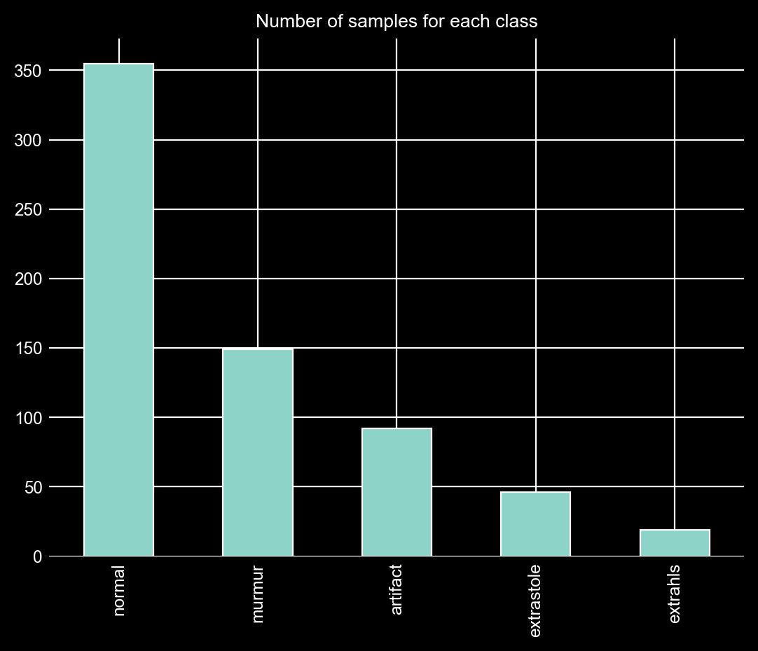

DATASET
SOURCE
Dangerous Heartbeat Dataset
STRUCTURE
Heartbeat audio
Different sources (Type A, B and C)
CLASS BALANCE
Highly imbalanced classes
Notes:
set - get method:
A - from the general public via the iStethoscope Pro iPhone app
B - from a clinic trial in hospitals using the digital stethoscope DigiScope
С - mixed, that is, both A and B categories are possible
GRAPH DESCRIPTION

Slide 7
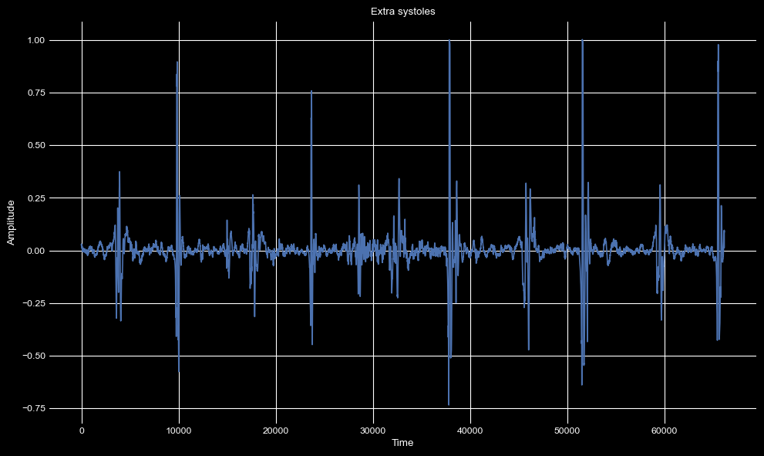
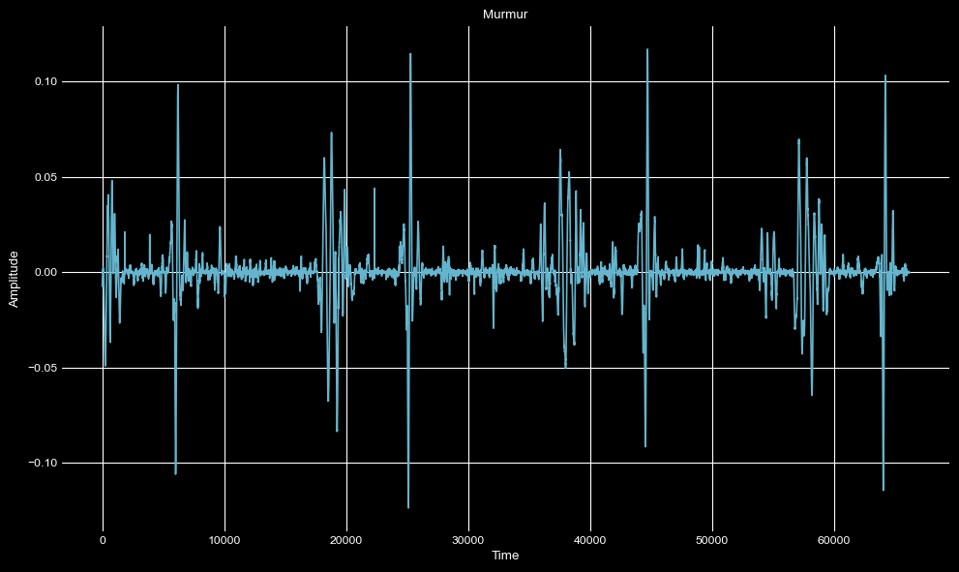
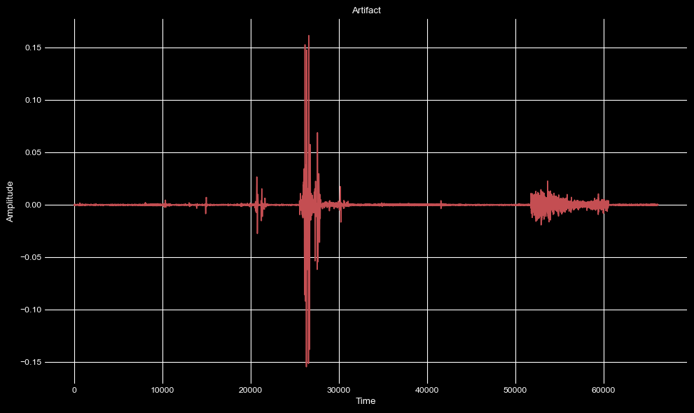
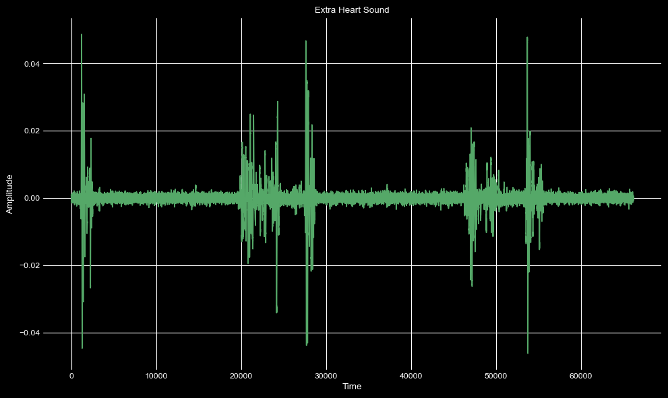
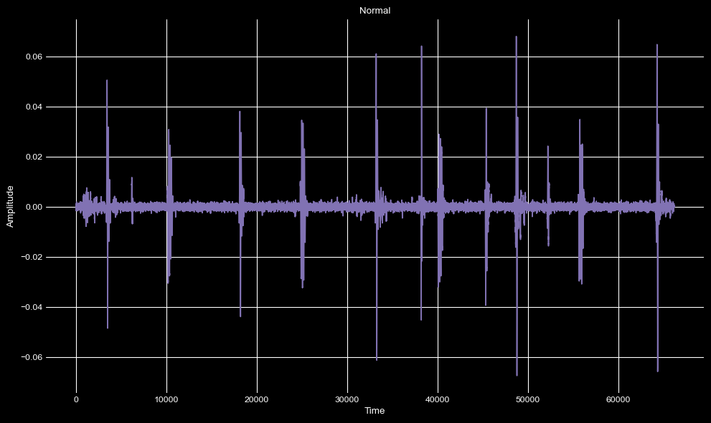
THE CLASSES
EXTRA SYSTOLES
MURMUR
ARTIFACT
EXTRA HEARTBEAT
NORMAL
Notes:
Artifact: contains noisy samples in which there is no heartbeat
Normal: normal cardiac cycle
Extra heartbeat: the cardiac cycle contains an additional heart beat
Extrastole: there are sporadic cardiac cycle that contain an additional or missed heartbeat
Murmur: Heart murmurs are abnormal sounds during the heartbeatcycle

Slide 8
PREPROCESSING
NOISE REDUCTION
CORRUPTED FILES
RESAMPLING
Audio clipped to reduce noise and irrelevant information
Corrupted files were deleted
All files resampled to a common frequency of 4000 Hz
SEGMENTATION
OUTLIERS
Files clipped into a fixed length of 1 second
Long lasting audios have been removed
Notes:
To prepare the data, we did several preprocessing steps involving:
Noise reduction
Corrupted file adn outliers deletion
Audio resampling and segmentation

Slide 9
FEATURES
MFCC
Chroma STFT
MFFCs can reflect the different perceived quality of heart sounds, such as the presence of murmurs or other anomalies
Captures the 12 pitch classes, useful for identifying harmonic patterns in heartbeat audio, aiding in anomaly detection
Root Mean Square Energy
Constant-Q Transform
RMS is used for detecting volume changes and can help identify different types of heartbeats based on their energy levels
Uses a logarithmic frequency scale, capturing more detail at lower frequencies, which is useful for analyzing the low-frequency components of heart sounds
Zero Crossing Rate
Spectral Bandwidth
ZCR can help differentiate between normal and abnormal sounds by highlighting changes in signal periodicity
This feature helps in understanding the spread of the frequency components in the heart sounds
Spectral Rolloff
Spectral Centroid
Can be used to differentiate between sounds with a concentrated or dispersed energy distribution
Represents the 'brightness' of a sound by indicating the center of mass of the spectrum
Notes:
We mainly used spectral features that extract information about the frequencies contained in the audio signal
We used MFCC which accordingly to the literature one of the best performing features in each type of audio classification task
But we also tried other feature like RMSE, ZCR which captures changes in signal periodicity and many others

Slide 10
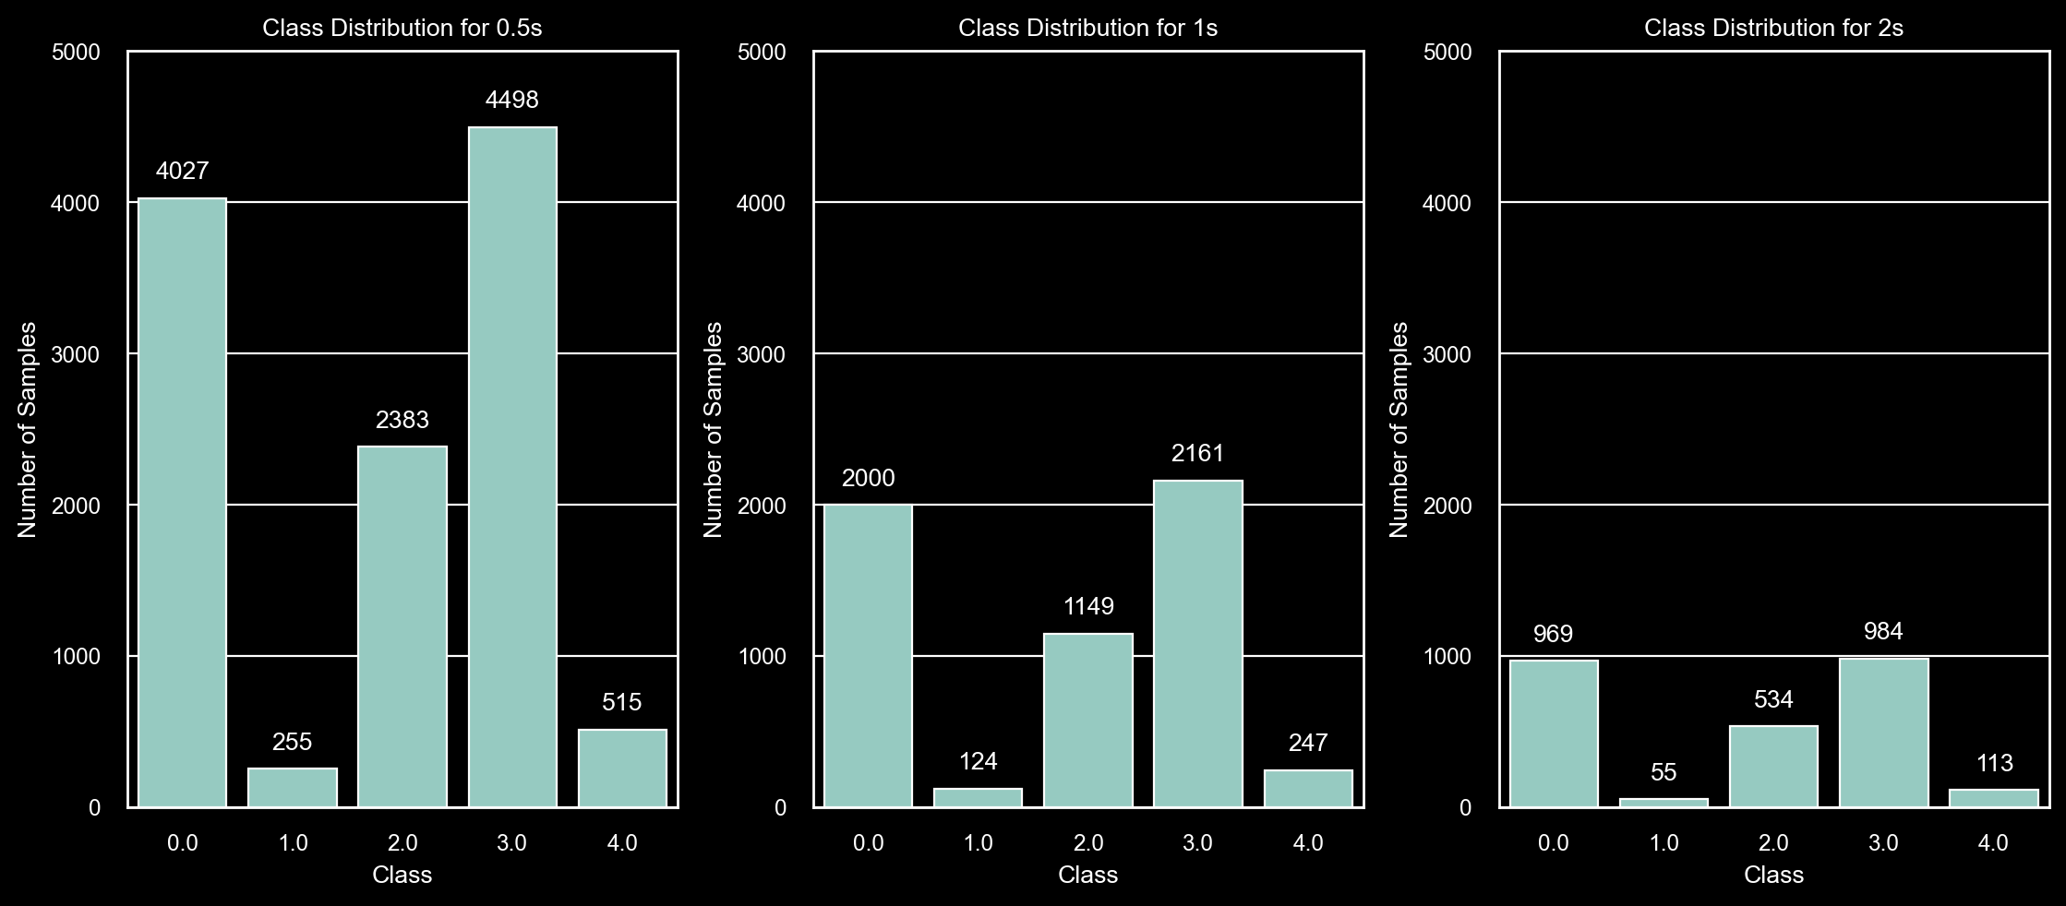
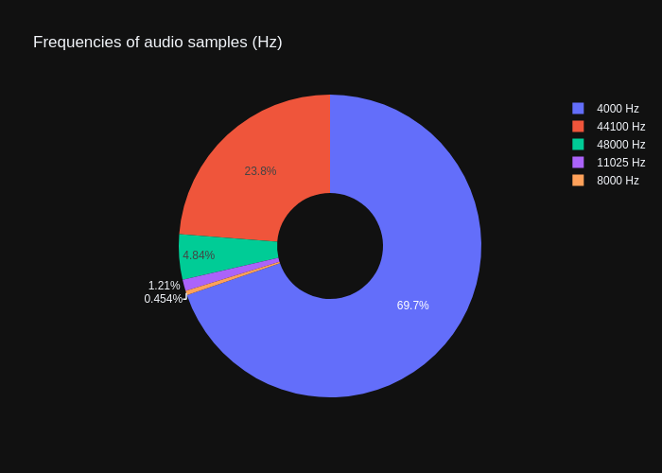
FEATURES EXTRACTION
EXTRACTION INTERVAL
SAMPLING RATE
Each audio is divided into chunks of 1 second as it offers good performance while augmenting at the same time the number of samples
All audios were resampled at the most common frequency (4000 Hz)
Notes:
To extract these features we had to take several decisions
Two of them are about the extraction interval which is the audio chunk length form which features are extracted and about the sampling rate
In both cases we did experimental tests with several extraction intervals and sampling rate and we retained 1 second as the best interval and 4000 hz as sampling rate

Slide 11
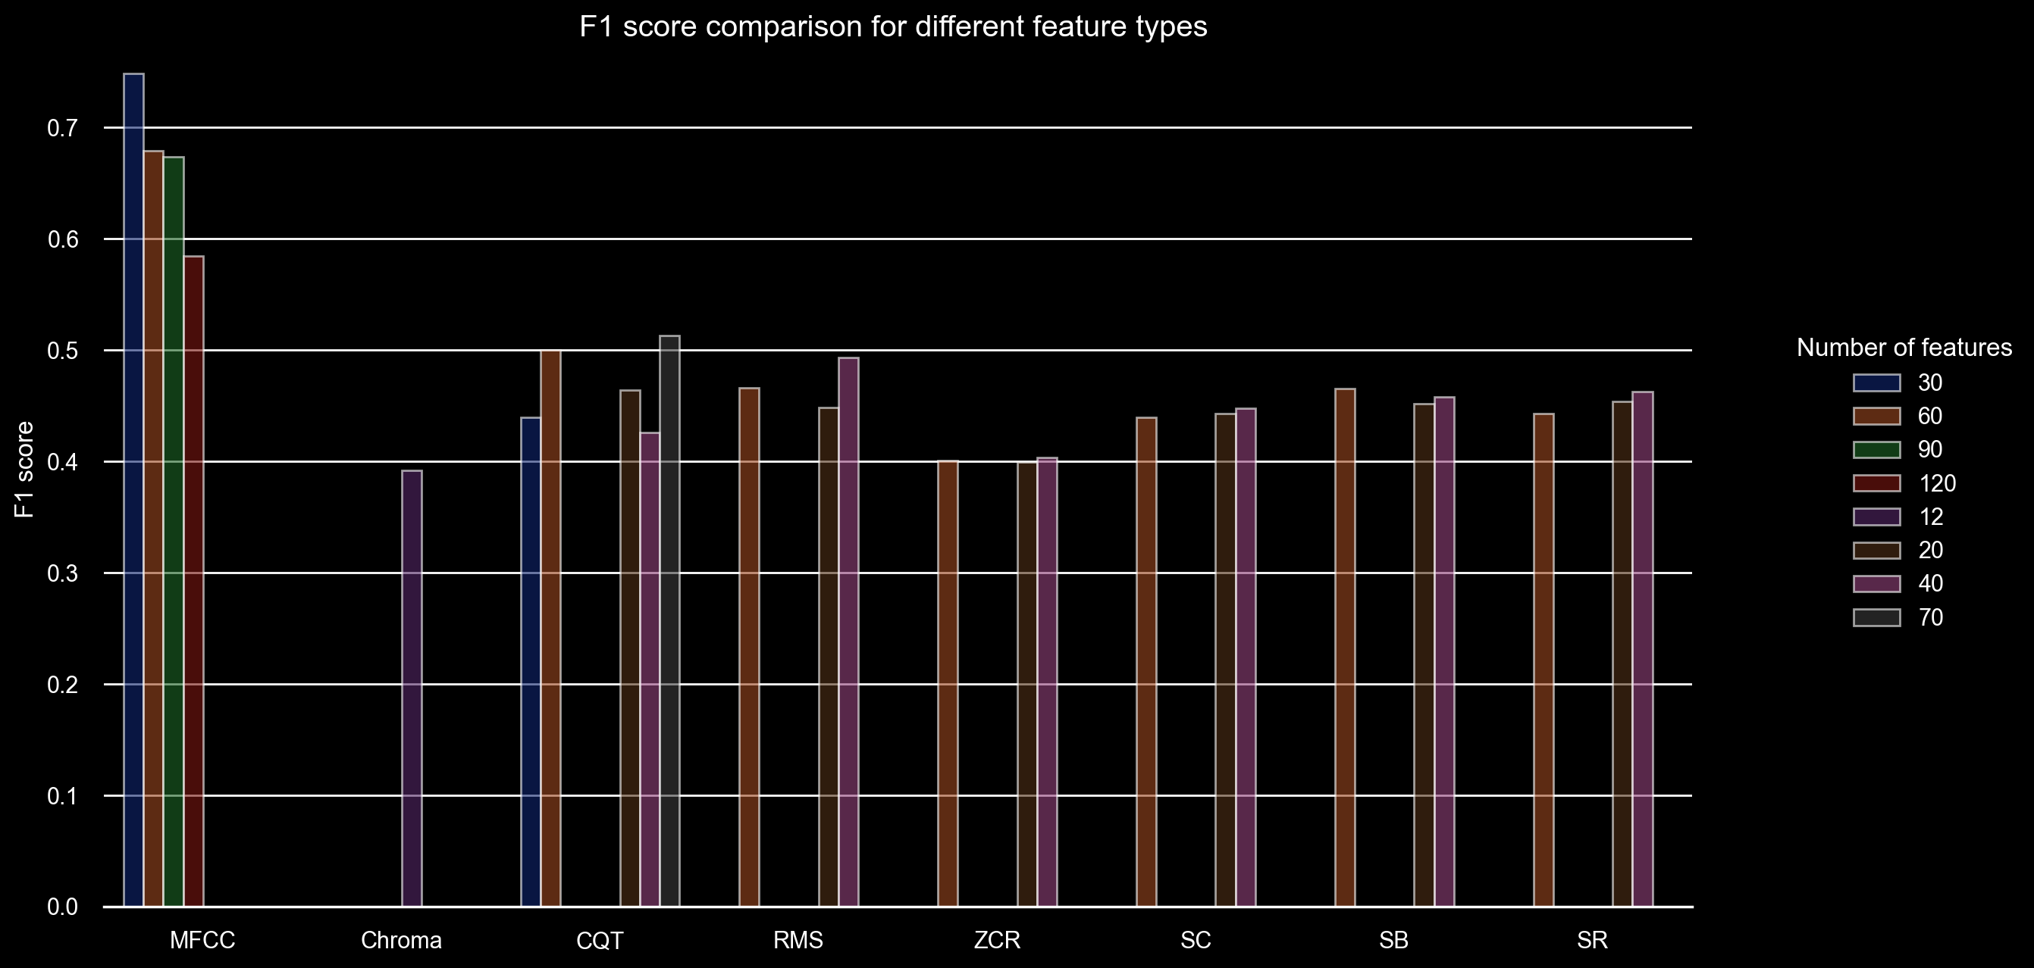
FEATURES EXTRACTION
TYPE | N° FEATURES
MFCC | 30
Chroma STFT | 12
CQT | 70
RMSE | 40
ZCR | 40
SB | 60
SC | 40
SR | 40
Notes:
The third decision is how many features should we have for each specific type?
To answer this question we trained a model on different numbers for each type and the results are shown in the table

Slide 12
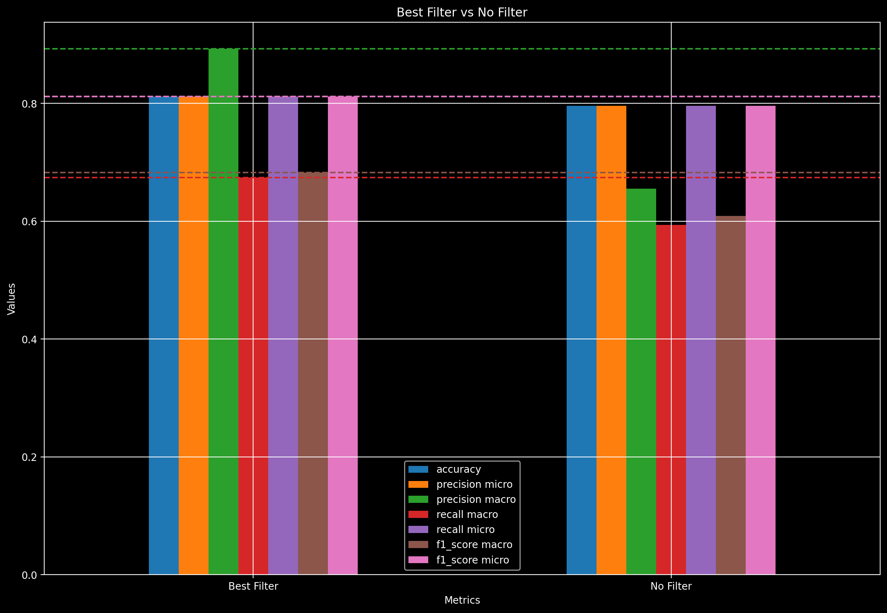
CORRELATION ANALYSIS
Correlation with Target
Removed features with a correlation lower than a threshold
Feature Correlation
Removed features with a correlation higher than a threshold with more than N other features
88 % features reduction
Notes:
Since we have more than 300 values extracted from the same it is important to consider the correlation.
Indeed highly correlated values end up throwing noise into the model, lowering its accuracy
To do that, we set 3 thresholds, the first regards the correlation with the target, the other two are about the correlation value between features and the number of highly correlated features.
We tried many combination of thresholds and the optimal one returns 40 features
The performance of the best filter are shown on the left graph, they significantly outperform the full features version

Slide 13
MODELS
PREVENTION MODEL
SUPPORT MODEL
Used for prevention and focused on distinguishing a normal heartbeat, from an abnormal one or an artifact
Specialized in identifying the specific disease and with explanaibility methods implemented
Notes:
Switching to the models, as we have already seen the purpose of this project is two folded and this reflects also in the models.
We followed two parallel paths. In the prevention oriented model we are not interested in distinguishing the type of disease, but only to say whether the disease is present or not, minimizing the false normals, so we used a FPR minimization approach
For the support model instead, we want also to be able to discriminate among the diseases with the highest accuracy, in an accuracy maximization approach. We also added explainability measures to try to explain how the model works.

Slide 14
ARCHITECTURES
Name | Architecture (hidden layers)
Random Forest | -
XGBoost | -
CatBoost | -
LightGBM | -
MLP Basic | (128, 64, 32)
MLP Ultra | (512, 256, 128, 64, 32)
MLP Large | (256, 128, 64, 32)
MLP Small | (64, 32)
MLP Tiny | (32, 16)
MLP Reverse | (32, 64, 128, 256, 512, 256, 128, 64, 32)
MLP Bottleneck | (512, 64, 32)
MLP Rollercoaster | (512, 128, 256, 128, 256, 64, 32)
MLP Hourglass | (512, 256, 128, 64, 32, 64, 128, 256, 512)
Name | Architecture (hidden layers)
MLP Pyramid | (1024, 512, 256, 128, 128, 128, 64, 32)
MLP Wide | (1024, 1024)
MLP WideUltra | (1024, 1024, 128, 32)
MLP Sparse | (32, 16, 8)
MLP Dropout | (128, 64, 32)
MLP Ensemble1 | MLP Basic, Large, Ultra
MLP Ensemble2 | RandomForest, MLP Ultra
MLP Ensemble3 | MLP Rollercoaster, Large
MLP Ensemble4 | MLP Rollercoaster, Large, Ultra
MLP Ensemble5 | RandomForest, MLP Ultra, Rollercoaster
MLP Ensemble6 | MLP Rollercoaster, Large, Ultra, Wide
ALL Ensemble | All models majority vote
CB ALL Ensemble | All models CatBoost
Notes:
Here you can see the list of the architectures used in the project.
We have basic ensemble models like RF and CatBoost, several versions of MLP and also more complex ensemble models based on soft voting that are made up by classical ensembles and MLPs

Slide 15
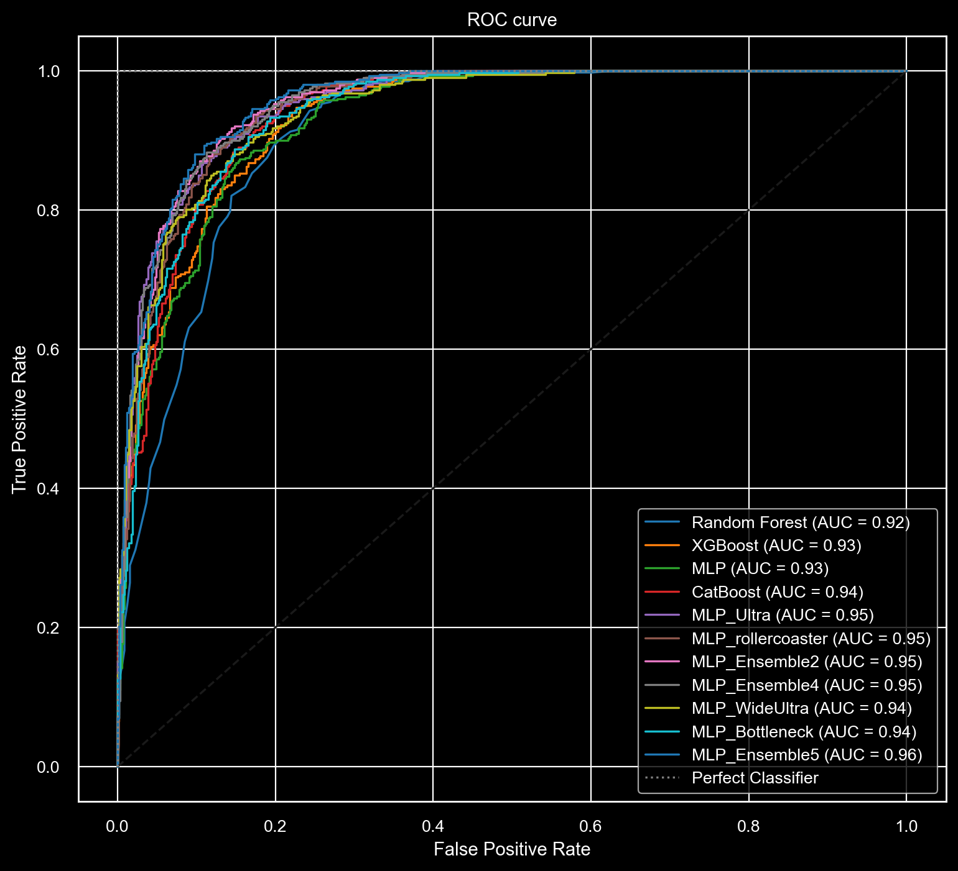
PREVENTION MODEL
Normal FPR Minimization Approach
Artifacts or abnormal heart sounds classified as normal are a big threat for the patient safety
At the same time TPR do not have to be disregarded, otherwise the model is unuseful
FPR vs TPR trade-off
Notes:
In developing our prevention model, our primary focus has been on minimizing the number of abnormal and artifact samples classified as normal.
This approach is essential to ensure patient safety, as misclassifying abnormal heart sounds could lead to missed diagnoses and delayed treatment.
we have also maintained a balance to ensure a high true positive rate.
This balance ensures that the model remains effective in identifying true cases of normalities,
As we can see from the graph, the best model is MLP ensamble 5, with AUC of 0.96

Slide 16
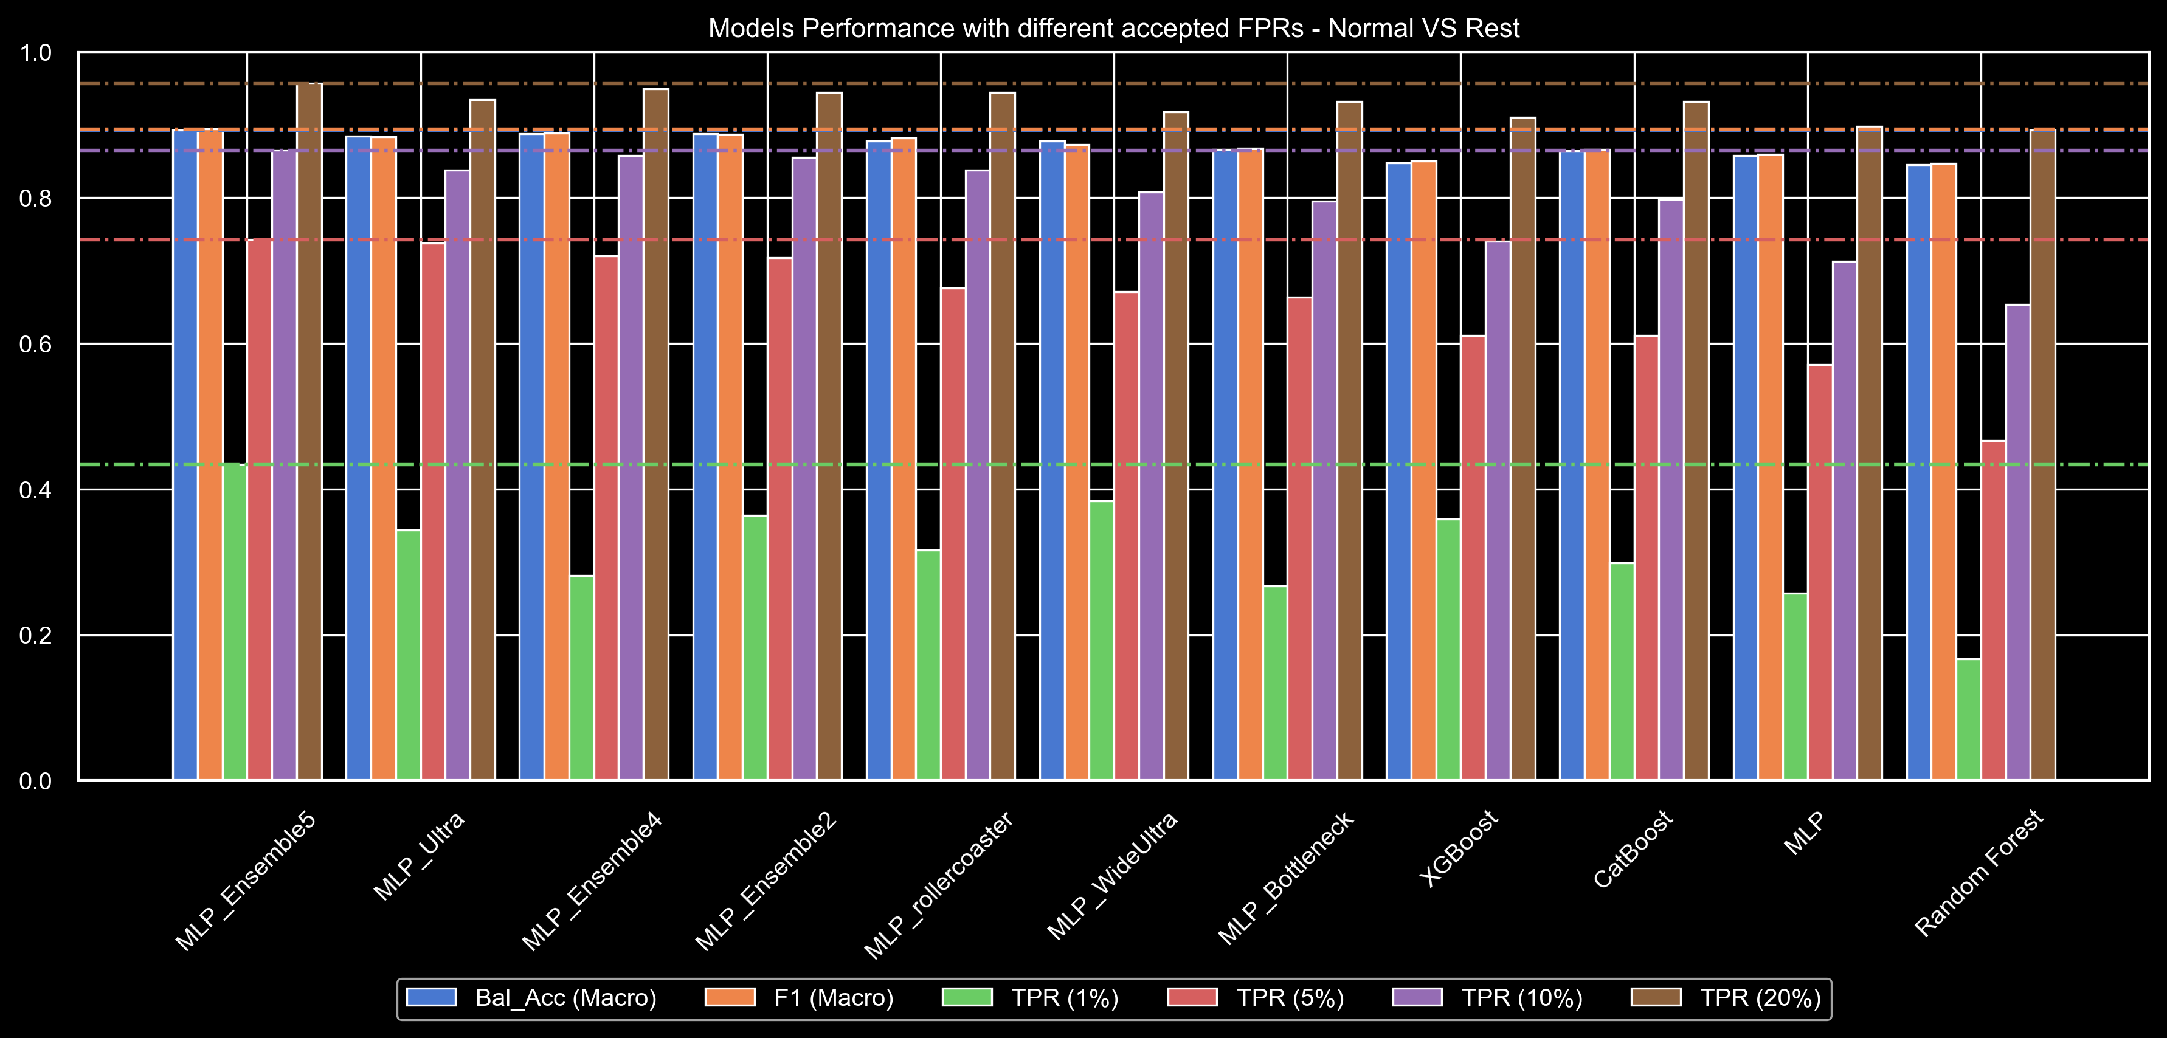
PREVENTION MODEL
Notes:
Since our focus is on low false positive rate we compared the TPR of all models with a FPR of 1,5,10,20 percent. As we can see for each teste value, ensamble 5 is the best one.

Slide 17
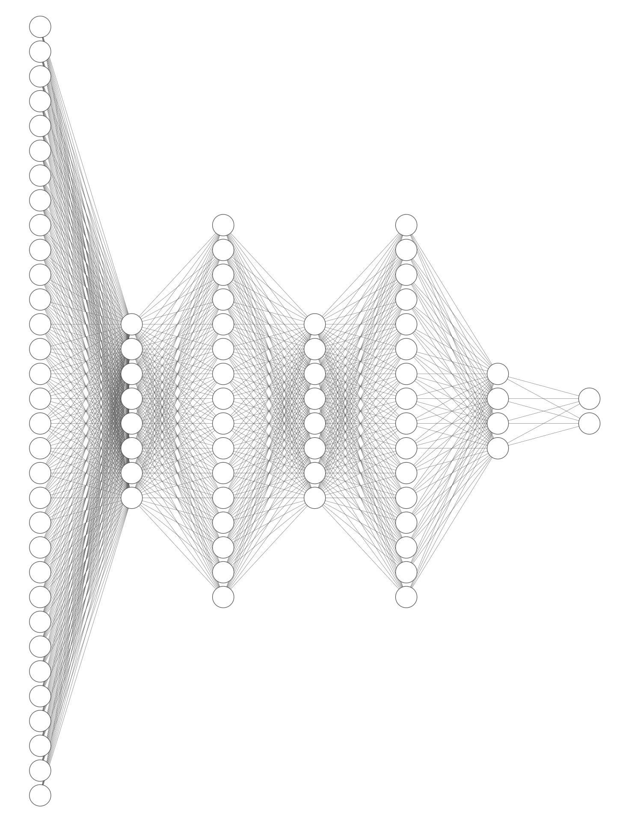
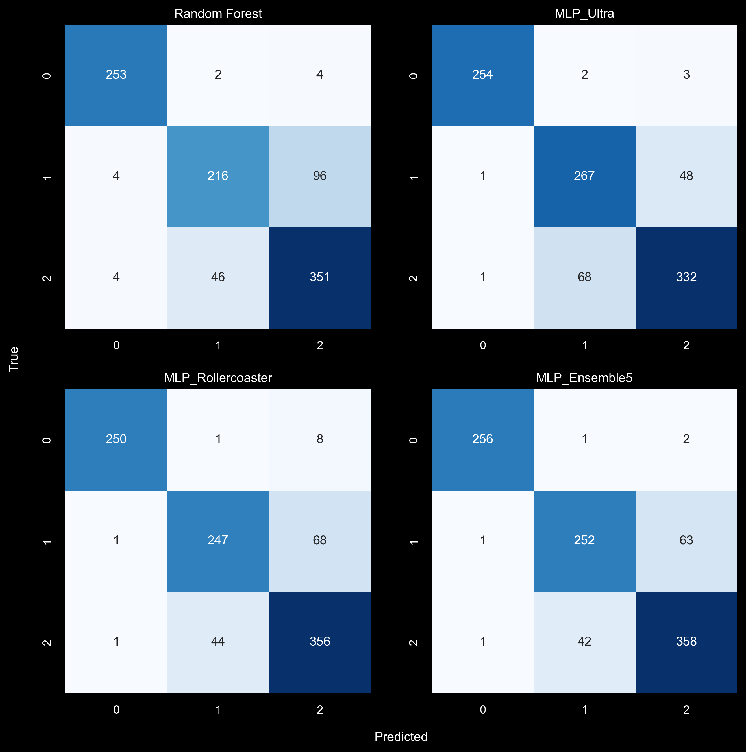


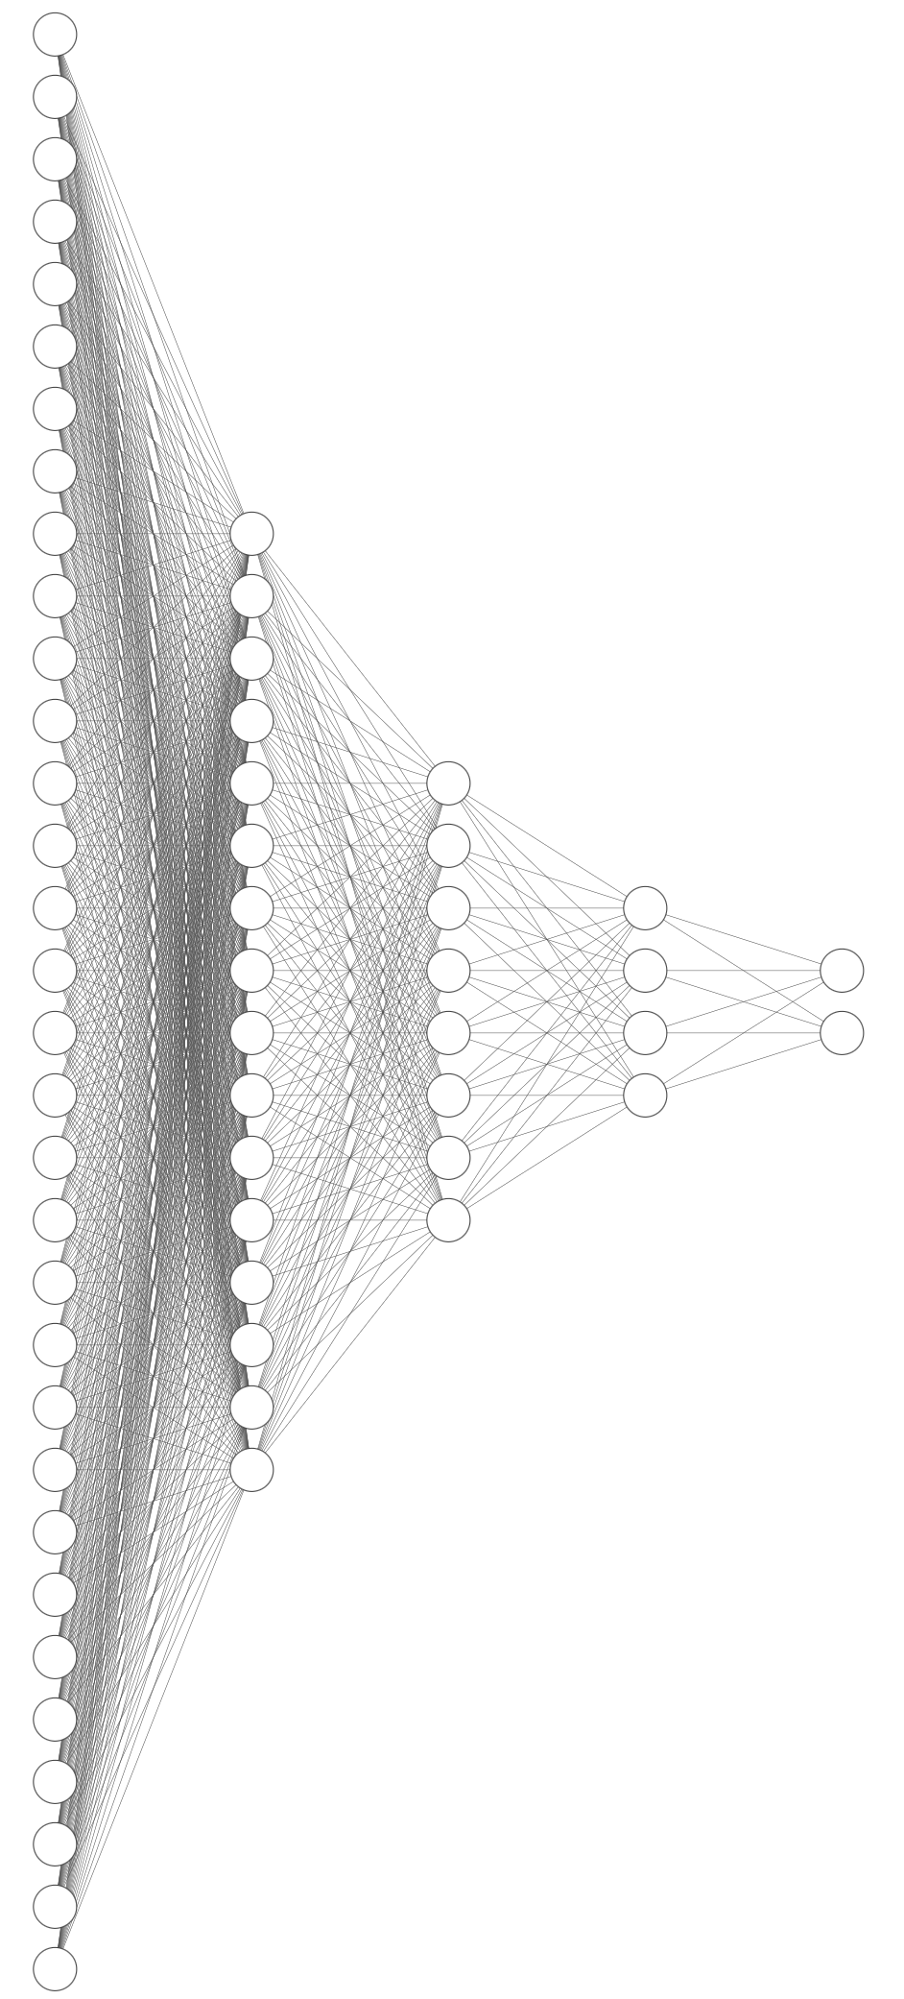









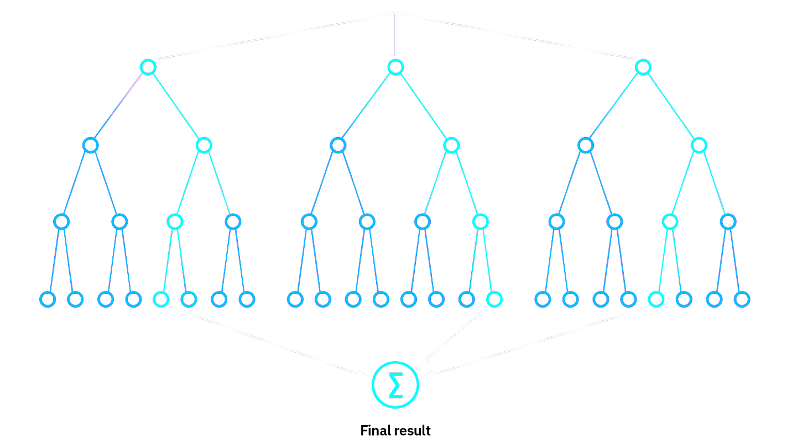
PREVENTION MODEL

Slide 18
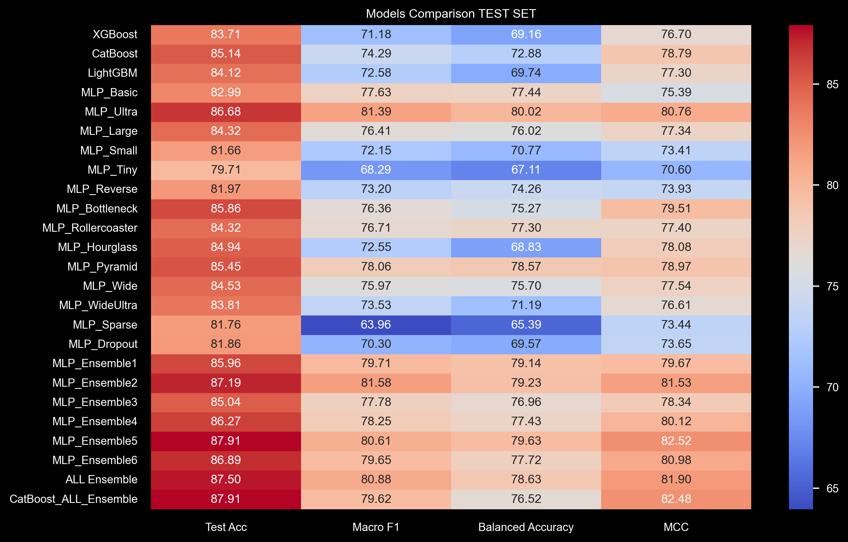
SUPPORT MODEL
Overall metrics Maximization Approach
The model must be capable not only to differentiate whether a diseases is present or not, but also which disease is present
Metrics considering the class imbalance were employed
To help the physician understanding the reasons behind each decision, explainability tools were used
Notes:
For what concerns the support model, the optimal model is taken considering its performances across all classes, because it have to identify also the diseases.
To evaluate the model’s performance we used metrics that consider the class imbalance which are more reliable estimators, like Macro f1 ….

Slide 19
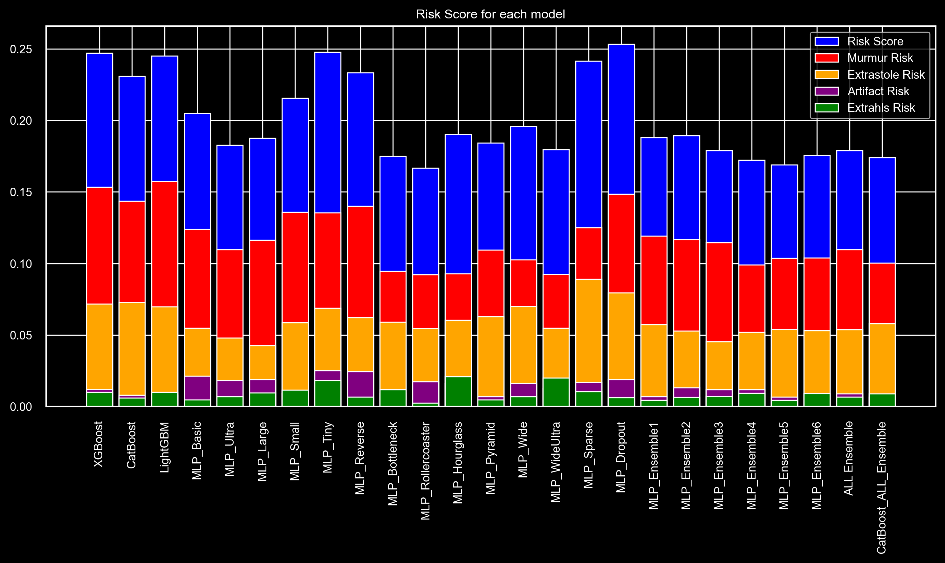
SUPPORT MODEL
Notes:
Also in this case we focused our attention on abnormal samples classified as normal.
We defined the risk score which is the number of abnormal samples classified as normal, normalised with respect to the total number of normal prediction
We computed this score for each non normal classes
The idea is to show that there isn’t only one best method, but it depend on what you would consider

Slide 20
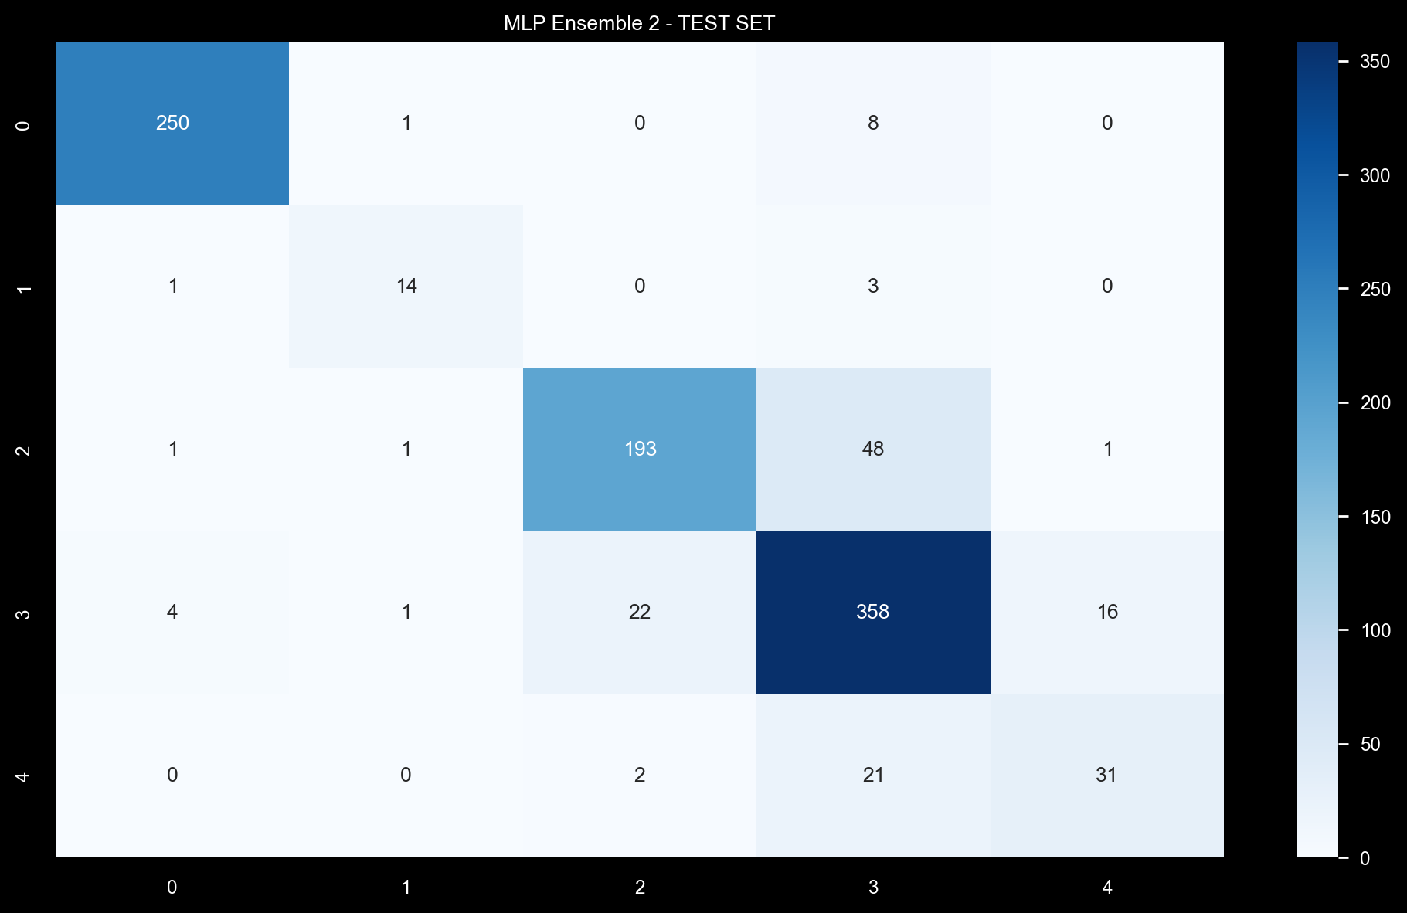
BEST MODEL – MLP Ensemble 2
Notes:
We took Mlp ensamble 2 as best model, because it maximise most of the metrics used. It is composed by 2 models.
As we can see from the confusion matrix it perform quite well on most of the classes, but it often confuses murmur and extrastoles with normal

Slide 21
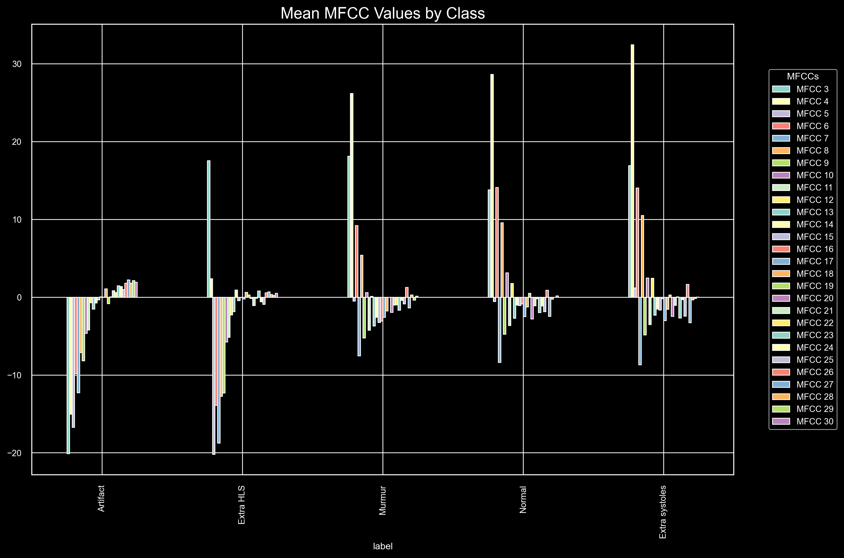
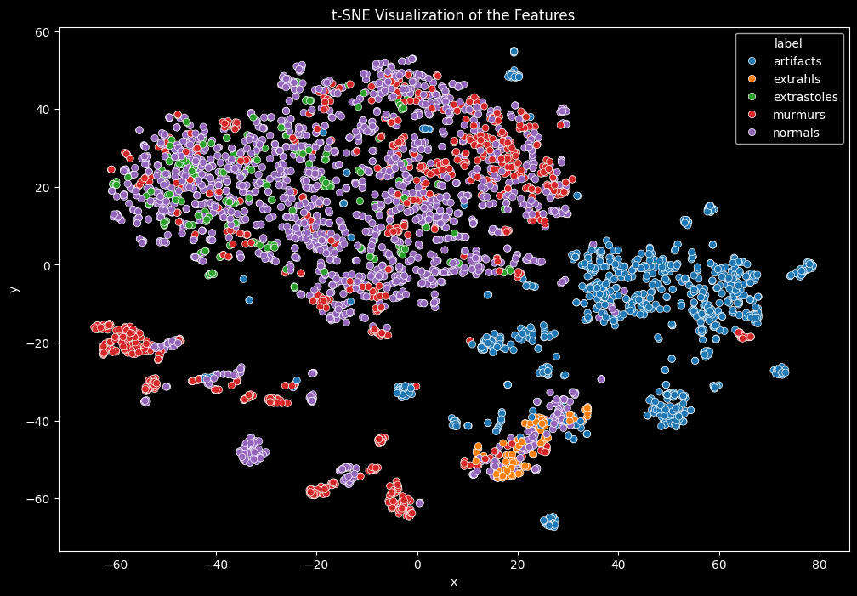
BEST MODEL – MLP Ensemble 2
Mean values across classes
Murmur, Normal and Extra Systole have similar MFCCs values
New features need to be introduced, to help discriminate among those classes

Slide 22
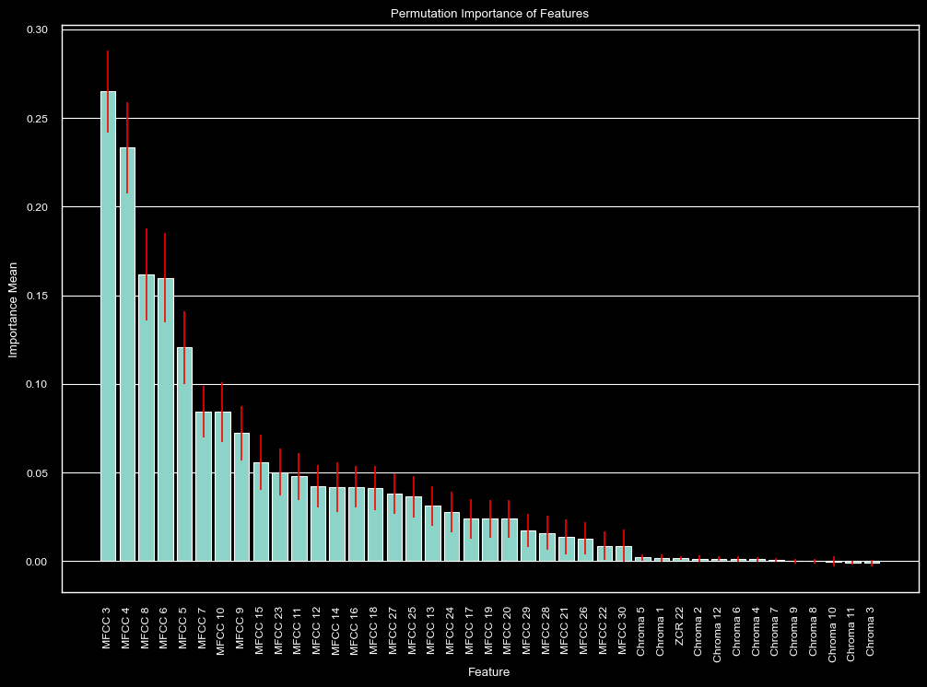
EXPLAINABILITY – MLP Ensemble 2
Permutation Importance
Compute different times the importance of the features. Bars are the mean values and red lines are the standard deviations
Main Takeaways
Most important features : MFCCs
Less important : Chroma STFTs
MFCC3 is the most important
Notes:
Switching to the explanaibility, we investigated , using the permutation importance method, the most impacting features on the model decision, so where the large majority of information lies
We can notice that The most important feature globally is MFCC 3 which roughly corresponds to a 78 Hz frequency bin and in general we can see MFCC are way more important than chroma

Slide 23
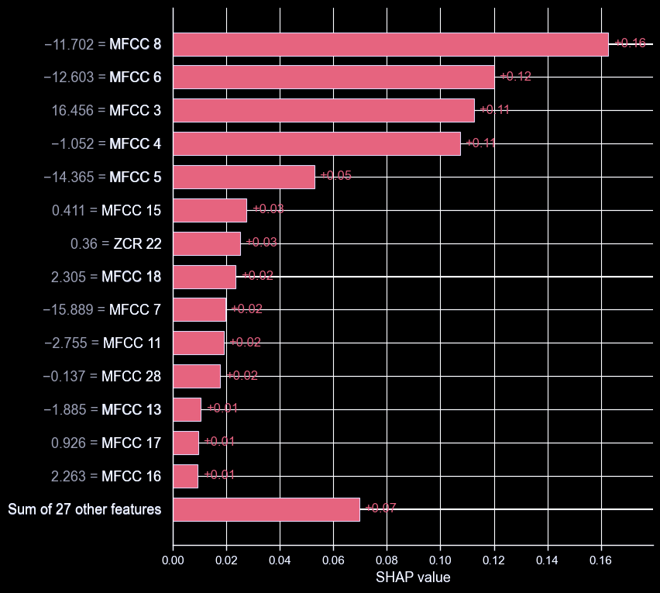
EXPLAINABILITY – MLP Ensemble 2
Feature importance
single prediction
Most impactful features in the predicition of a extrahls sample, according to SHAP
The higher the value of the bar, the higher the probability of having the extrahls class for the given sample
Notes:
To further explain the model we pick a sample from the extrahlas class and we investigated the most impacting features for that specific sample using SHAP
A positive value of the bar means that feature votes in favor of the correct class for that sample, so the first are the most impactful
In this case we have that a positive value of MfCC3 votes in favor of class extrahls and the same holds for negative values of 8 and 6
If we trace back the MFCCs to the original waveform we can then look for points in which this happens and those are the most important zones for the model

Slide 24
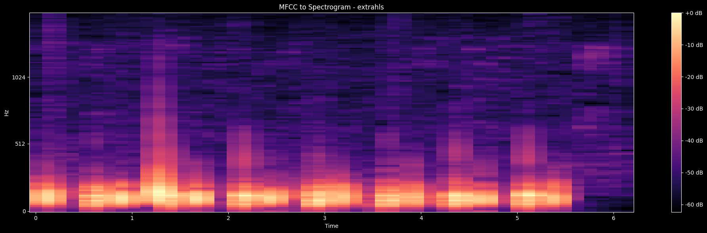
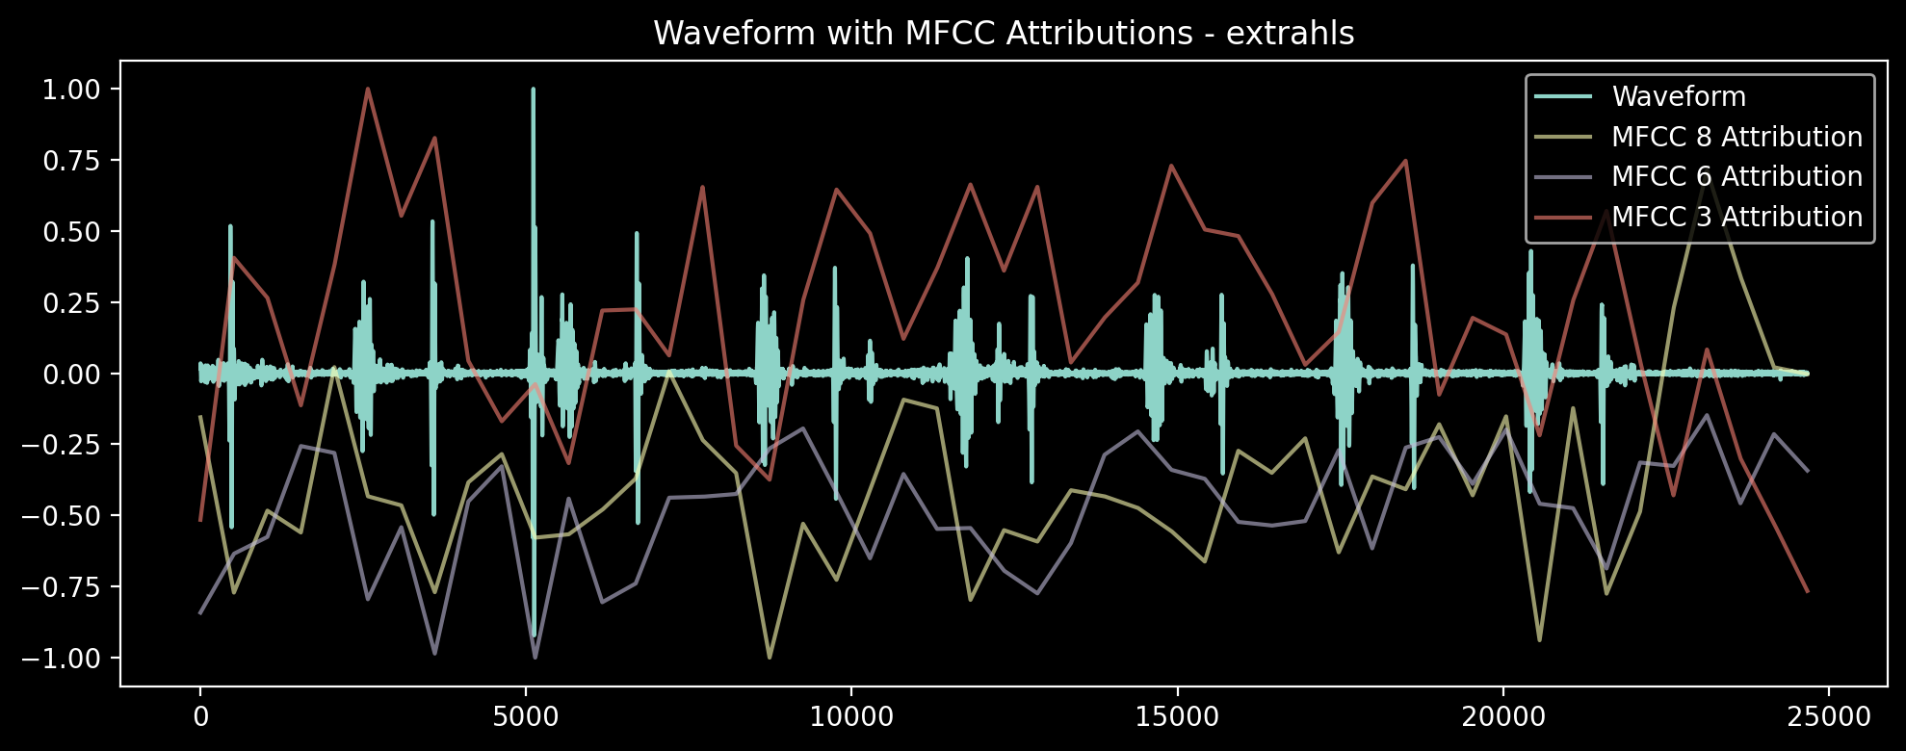
EXPLAINABILITY – MLP Ensemble 2
Frequencies distribution across time
Most meaningful zones for the model
Notes:
We did that
In the first figure there is the spectrogram of the chosen sample and we can see that the most important frequencies are the lower ones as expected for an heartbeat
In the second image instead we have the how the MFCCs varies across time, depending on the signal. The most important points for this sample are then those included in the white frames, where we can see the MFCC 3 is high and the others are low.

Slide 25
OTHER EXPERIMENTS
CNN Based on Spectral Features
Spectral features converted into images
VGG16 with Batch Normalization as a features extractor
Promising results that may be optimal after fine tuning
CNN Based on waveforms
VGG16 with Batch Normalization, using raw waveform images Features taken from 3rd, 4th and 5th convolutional layer after pooling Tried different classifiers (RF, MLP, SVM) with no relevant results
Notes:
We also did several other tests
We experimented a CNN based approach with spectral features, which led to promising results that may become optimal after fine tuning
We also used VGG16 as feature extractor from the raw waveform images followed by a classification algorithm. We tried taking the features from the 3,4,5 convokutional layer but is no cases the results were relevant

Slide 26
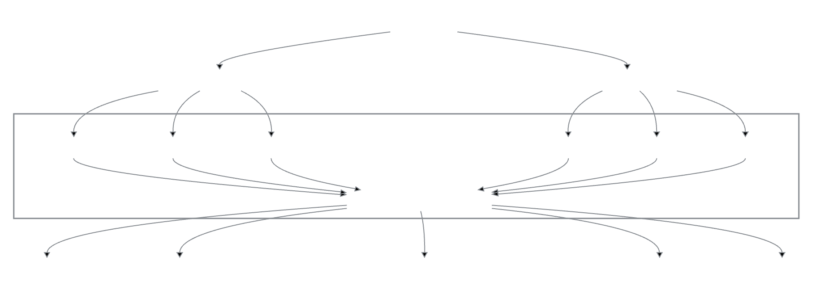
OTHER EXPERIMENTS
Tiered Ensemble Model
Data Augmentation
We tried to augment the training data of the under represented classes by adding noise and changing speed and pitch. No relevant improvement showed.
Notes:
- we used data augmentation to augment the less represented classes but the improvement was small
- We also tried a new tiered ensemble model where we split the problem into two part. A first on in which we trained a model to classify the disease only and another to classify audio as normal abnormal or artifact. We then used a third model to make the final prediction, the result were interesting but not good as the best we achieved.

Slide 27
FUTURE WORKS
Highly imbalanced classes and difficult to balance (increase the dataset), we had to make many trade-off choices.
Inability to create a validation set to find the hyperparameters, test metrics are biased.
Evaluate the techniques used with clinicians and their consistency with medical aspects, especially for the explainability phase
Experiment with other features. MFCC resulted not discriminant for 3 classes

Slide 28

THANKS!
AndreaAlberti07
DavideLigari

Slide 29
REFERENCE
Zhang, W.; Han, J.; Deng, S. Heart Sound Classification Based on Scaled Spectrogram and Tensor Decomposition. Expert Syst. Appl. 2017, 84, 220–231
Shi-Wen Deng, Ji-Qing Han, Towards heart sound classification without segmentation via autocorrelation feature and diffusion maps, Future Generation Computer Systems, 2016
Raza, A.; Mehmood, A.; Ullah, S.; Ahmad, M.; Choi, G.S.; On, B.-W. Heartbeat Sound Signal Classification Using Deep Learning. Sensors 2019
Alafif T., Boulares M., Barnawi A., Alafif T., Althobaiti H., Alferaidi A. Normal and Abnormal Heart Rates Recognition Using Transfer Learning; 2020
Noman F., Ting C.-M., Salleh S.-H., Ombao H. Short-segment heart sound classification Using an ensemble of deep convolutional neural networks; 2019
Chen L., Ren J., Hao Y., Hu X. The Diagnosis for the Extrasystole Heart Sound Signals Based on the Deep Learning. J. Med. Imaging Health Inform. 2018

